Slide 1
Business view of information technology Applications
The business world

Slide 2
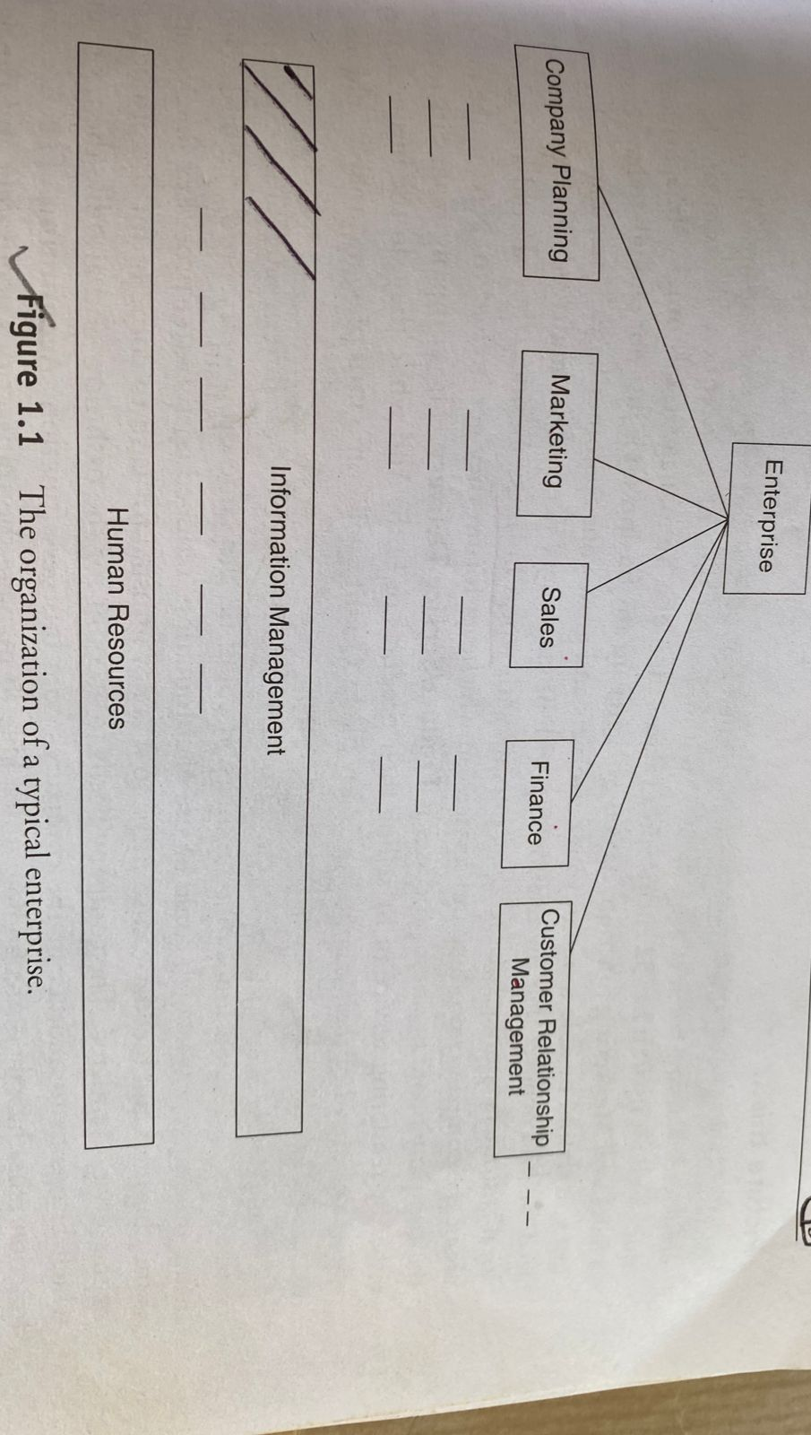
Business Enterprise Organization, Its Functions and Core Business Process

Slide 3
Core Business Process
Sales and Marketing
Product or Service delivery
Quality
Product Development
Accounting
Technology
HR
Supplier management
Legal and Compliance
Corporate planning
Procurement (Purchases)

Slide 4
KEY PURPOSE OF USING IT IN BUSINESS
All the outset we will start with the idea that IT is used to Automate business processes.
The use of IT to innovate new ways of doing business results in huge benefits for the enterprise and gives it leadership position in the market.
All of us have used software like email, Google search tool, word process, spreadsheet and presentation tools that enhance personal productivity.
Consider an IT application like “Payroll processing". Salary payable to the employees. To solved this problem Departmental IT Applications have developed.
On-line Transaction Processing systems:-IT application like train/bus/airline ticket reservation system.speed,accurancy,search capability, status inquiry, easy update ability and so on.
Business Process/Model Innovation:-book store. We can transfer the money across the globe to any bank account from home is a new innovation.

Slide 5
Continued…
Decision support: these application need to gather data from various sources, for them into the user preferences and present recommendations with ability to show more details when the user needs it.
IT application are:- office productivity/office automation IT application, departmental IT applications, Enterprise level on-line transaction processing applications, business process or model Innovation applications, decision support applications.

Slide 6
Characteristics of internet-ready IT applications
Computer networks are the basic foundation platform on which the entire IT infrastructure is built.
The majority of users access the enterprise and departmental applications either over LAN or Through Internet in a secure fashion.
All enterprise data that is critical to the business is invariable stored on server system spread across several locations with built-in mechanisms.
The servers are secured with several hardware/software security solutions so that unauthorized access.
Operating system, RDBMS software. Application server software, middleware soft and IT applications.
Enterprises strive to provide “single sign-on”.
It’s all about context sensitive menus, online help, navigation using touch screen/mouse ,high resolution graphical display.

Slide 7
Technology centric Applications-from 1965-2000 to future.
Customer applications
OS
Customer applications
DB Server
OS
Customer applications
Application server
DB Server
OS
Network
Web services
Customer applications
Application Framework
Application server
DB Server
OS
OS
1965-1980
1980-1995
1995-2000
2000 - Future

Slide 8
Internet-ready applications do have several advanced common capabilities like
Support large number of users of different interests and abilities.
Provides display on multiple devices and formats.
Deployed on large secure servers through license management software.
Support single sign-on and support special authentication and authorization requirements.
Ability to run on any operating system.
Could be implemented in multiple programing languages or combination as well.
Leverages enterprise storage capabilities and back-up systems.
Supports extensive connectivity to different types of networks and internet services.

Slide 9
Enterprise applications and bespoke IT applications
A classification based on function and purpose such as office automation business,
Business innovation, Decision support.
Another key classification based on parameter for IT applications is the users. Like customer facing, partner/supplier facing and employee facing applications, customer relationship management, supply chain management, human capital management, financial accounting ,customer order processing, customer order fulfillment, product distribution management, procurement management.
As they say are the ones who understand business process steps very well, such enterprises will invest in hardware software, development tools and testing tools, and own the entire soft lifecycle responsibility. This is termed as bespoke application development.

Slide 10
Visualizing IT applications
All the IT application required to run enterprise will never be created at the same time there will be several generations of application developed or purchased over several years.
All IT application need maintenance as business rules and business environment change and IT application be at a different stage of maintenance at any given point of time.
Enterprises choose the optimum hardware,software,OS,RDBMS,network and programming language available at the time of making build or buy decision.
Enterprises may loosely bring together several applications in an enterprise portal but limitations in terms of data exchange across IT applications.
Enterprise may design new applications to combine data from several critical data sources the management information system(MIS).

Slide 11
INFORMATION USER AND THEIR REQUIRMENTS
Employees,partners,suppliers,customers,investors,analysts,prospective employees, and general public interested in the business affairs of the enterprise.
Office goers,mobile users, home office users, remote securely connected users, casual visitors to website and digital users who conducted transactions using the internet.
Role-base users who have access to certain category of IT applications, certain level of classified information, access to specific system and even specific operations.
Securely connected users who may be allowed to access specific servers from specific location.
Administrative users, who configure the IT environment, manage users access control.
Users who have permission to read or update or have full control over the enterprise information.
Knowledge workers/analytical users who discover new patterns in the enterprise data.
Multi-device access users who sometimes work in office or other device.

Slide 12
TYPE OF DIGITAL DATA
Unstructured.
Semi-structured.
Structure.
Unstructured data:-this is the data which does not conform to a data model of is not a form which can be used easily by a computer program. About 80-90 % data of an organization is in this format.
Semi-structure data:- this is the data which does not conform to a data model but has some structure.However,it is not in a form which can be used easily by a computer programming .example emails,XML,markup languages like HTML.
Structure data:-this is data which is in an organized form (e.g,in rows and columns)and can be easily used by a computer program, relationships exit between entities of data such as class and their objects.

Slide 13
Getting into “goodlife” database
Doctors and nurses notes an electronic report.
Emails sharing information about consultations or investigations.
Surveillance system report.
Narrative portions of electronic medical records.
Investigative reports.
Chat rooms.
Patient ID | <> | Data | <>
Nurse name | <>
Patient name | <> | Patient age | <>
Body temperature | <> | Blood pressure | <>

Slide 14
Characteristics of structured Data
Conform to a data model
Similar entities are grouped
Data is stored in the form of rows and columns
Structured data
Attributes in a group are the same
Data resides in fixed fields within a record or file
Definition, format and meaning of data

Slide 15
Sources of structured Data
Databases .e.g Access
spreadsheets
spreadsheets
Structured Data
SQL
SQL
OLTP systems

Slide 16
Ease with structured data
Storage
Scalability
Ease with structured Data
Security
Update and delete

Slide 17
Ease of retrieval of structured data
Retrieving information
Hassle-Free Retrieval
Indexing and searching
Ease with structured Data
Mining Data
BI operations

Slide 18
GETTING TO KNOW UNSTRUCTURED DATA
Does not conform to any data model
Cannot be stored in the form of rows and columns as in a database
Has easily identifiable structure
Unstructured data
Does not follow any rules or semantics
Not in any particular format or sequence
Not easily usable by a program

Slide 19
Source of unstructured data
Web page
memos
videos
images
Body of email
Word documents
Unstructured Data
PPT
chats
reports
papers
surveys

Slide 20
Challenges faced while storing unstructured data
Storage space
scalability
Challenge faced
Retrieve information
security
Update and delete
Indexing and searching

Slide 21
Possible solutions for storing unstructured data
Change formats
New hardware
Possible solutions
RDBMS/BLOBs
XML
CSS

Slide 22
Challenges faced while extracting information from stored unstructured data
interpretation
Tags
Challenges faced
indexing
Deriving meaning
File Formats
Classification/
taxonomy

Slide 23
Getting to know semi-structured data
Semi structured data does not conform to any data model,i.e.it is difficult to determine the meaning of this data.
Also this cannot be stored in rows and columns as in a database.
Semi-structured data,however,has tags and markers which help group the data and describe how the data is stored. But they are not sufficient for management and automation of data.
In semi-structured data, similar entities are grouped and organized in a hierarchy. The attributes or the properties within a group may or may not be the same.

Slide 24
Characteristics of semi-structured data
Does not conform to any data model but it contains the tags
Cannot be stored in the form of rows and columns as in a database
Similar entities are grouped
Semi-structured data
Attributes in a group may not be the same
The tags and elements describe data is stored
Not sufficient meta data

Slide 25
Sources of semi-structured data
Zipped files
Email
XML
TCP/IP packets
Binary executable
Mark-up languages
Semi-structured Data
Integration of data from heterogeneous sources

Slide 26
Continued…
It is organized into semantic(relation) entities.
Similar entities are grouped together.
Entities in the same group may not have same attributes.
The order of attributes is not necessarily important.
Not always all attributes in a group may differ.
Type of the same attributes in a group may differ.

Slide 27
How to manage semi-structured data?
Schemas: these can be used to describe the structure of data by using schemas.
Graph-based data models: these can be used to describe data.
XML: This is widely used to store and exchange semi-structured data.

Slide 28
How to store semi-structured data?
Storage Cost
RDBMS
Challenges faced
Irregular and partial structure
Implicit structure
Distinction between schema and data
Evolving schemas

Slide 29
XML
RDB
Possuble Solutions
Special purpose
DBMS
Object Exchange model

Slide 30
Difference between semi-structured and structured data
Semi-structured data is the same as structured data with one minor exceptions.
Semi-structured data requires or examining the data element name.
Semi-structured data is one processing step away from structured data.
From data point of view, there is no difference between Semi-structured data and structured data.
An analyst’s point of view, there is a huge difference because the analyst needs to create the data elements source/target mapping.

Slide 31
Name | Email
Patrick wood | ptw@dcs.abc.ac.uk
First name:Mark Last name:tahlor | markT@gmail.com
Alex B | AlexB@yahoo.com
First name | Last name | Email-Id | Alternate Email-id
Patick | Wood | ptw@g | p.wood@yahoo
Mark | Taylor | MarkT@g
Alex | Bourdoo | Alex@red

